Slide 1

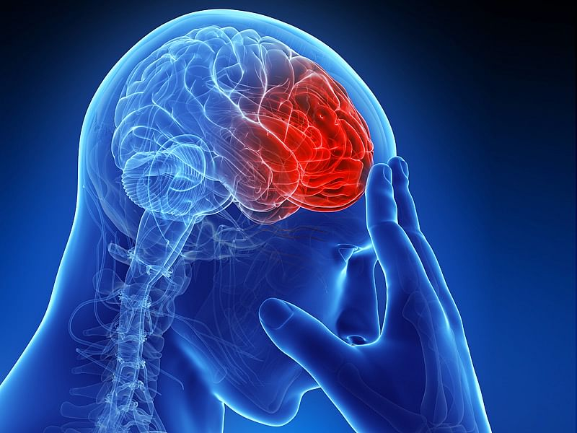
Brain Stroke Analysis
Brain Stroke Analysis
DAB 304– Healthcare Analysis

Slide 2
GROUP 3
Akshar Patel - 0793127
Vaibhav Patel - 0772934
Kush Patel - 0792972
Hiren Patel - 0797548

Slide 3
Content
Why Brain-Stroke
Problem Statement
Project Objectives
Dataset Information
Data Exploration and Visualization
Why Machine learning?
Comparison of Models
Challenges
References

Slide 4
Why Brain-Stroke?
Brain-stroke is a kind of disease that is known from so many years but, majority of the people is not aware about the disease itself, it’s causes and its immediate symptoms.
So, we thought we should focus on this topic to bring awareness in the society about this deadly disease if not treated on time.

Slide 5
Problem Statement
The main problem for getting a stroke is high blood pressure.
Here, other various risk factors embody high blood cholesterol, tobacco smoking, polygenic disorder mellitus, obesity, a previous TIA as well as end stage excretory organ diseases & chamber fibrillation

Slide 6
Problem Objectives.
The main objective of this problem was to predict the causes of brain-stroke using different concepts of Machine Learning.
The another objective was to create dashboard to show predictions in different visual forms.
We desired to achieve this objectives to bring awareness about the serious brain-stroke disease.

Slide 7
Dataset Information
Our dataset cites the causes of brain-stroke.
There are different reasons due to which brain-stroke occurs such as hypertension, recurring heart disease, the type of work people does, obesity, recurring disease such as diabetes, and smoking.
It contains 11 columns and around 5000 rows.

Slide 8
Demographic Study
Data Exploration and Visualization

Slide 9
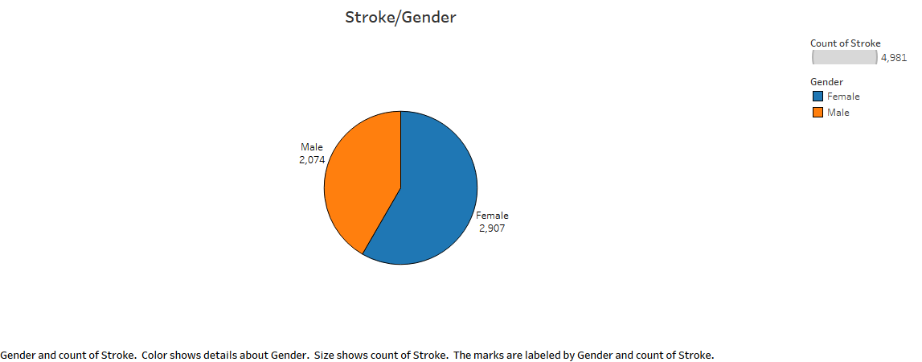
Gender affected by Brain-Stroke

Slide 10
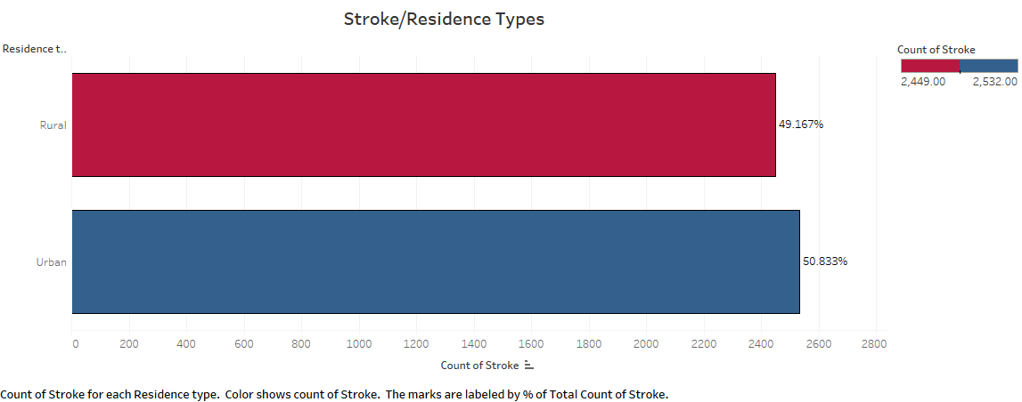
Residence got affected by Brain-Stoke

Slide 11
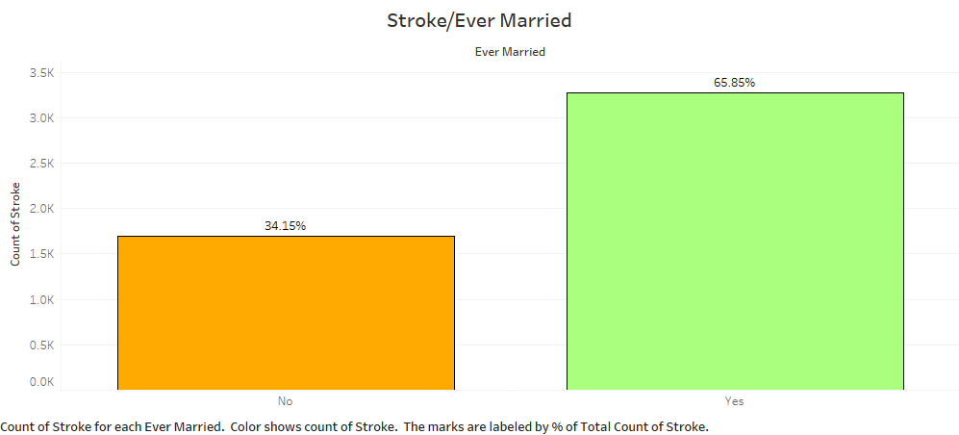
Stroke by Martial Status

Slide 12
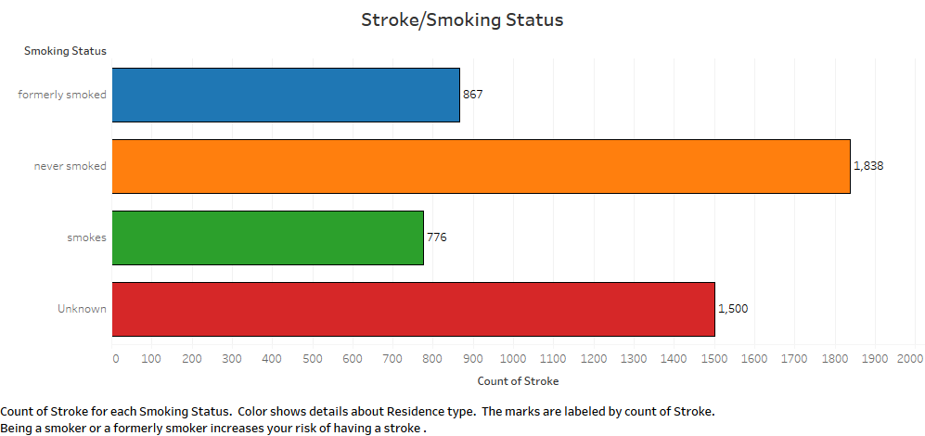
Stroke by Smoking habits

Slide 13
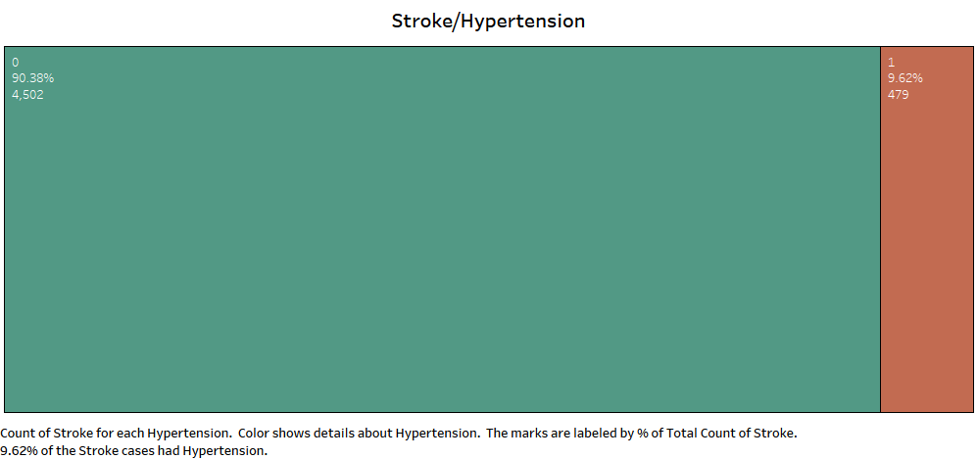
Brain Stroke due to Hypertension

Slide 14
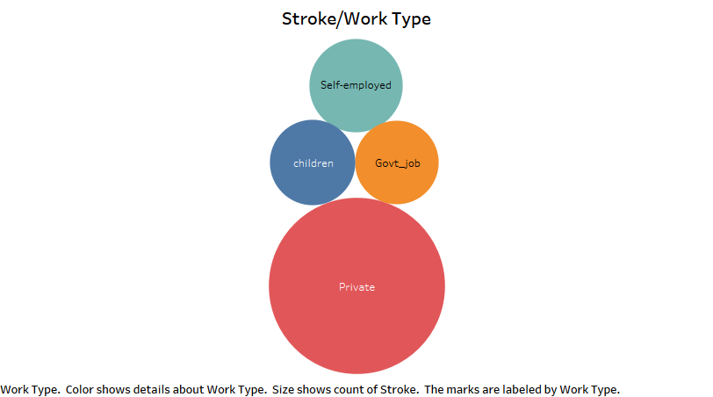
Types of work causes Brain Stroke

Slide 15
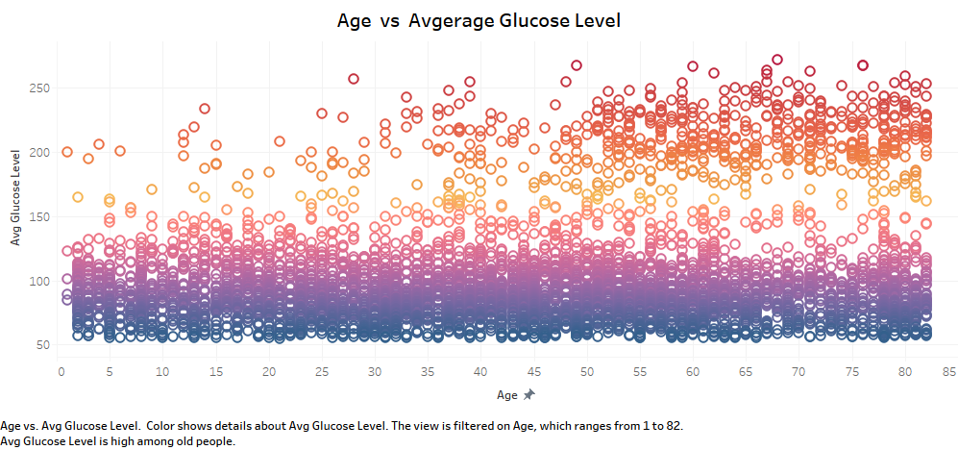
Glucose level per Age factor

Slide 16
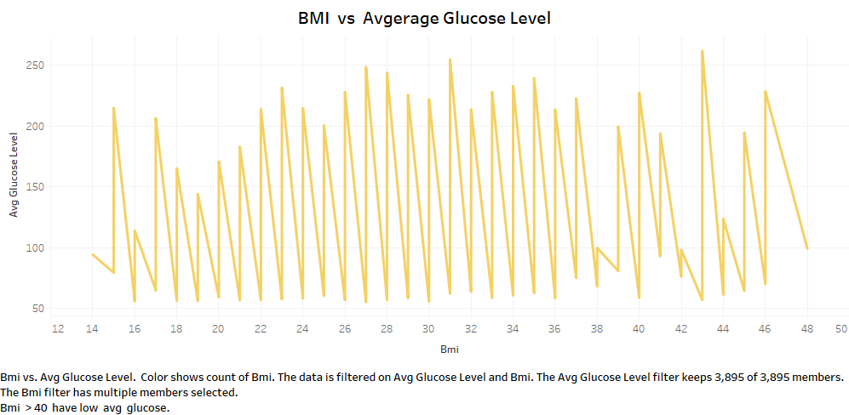
Glucose level per Body Mass Index

Slide 17
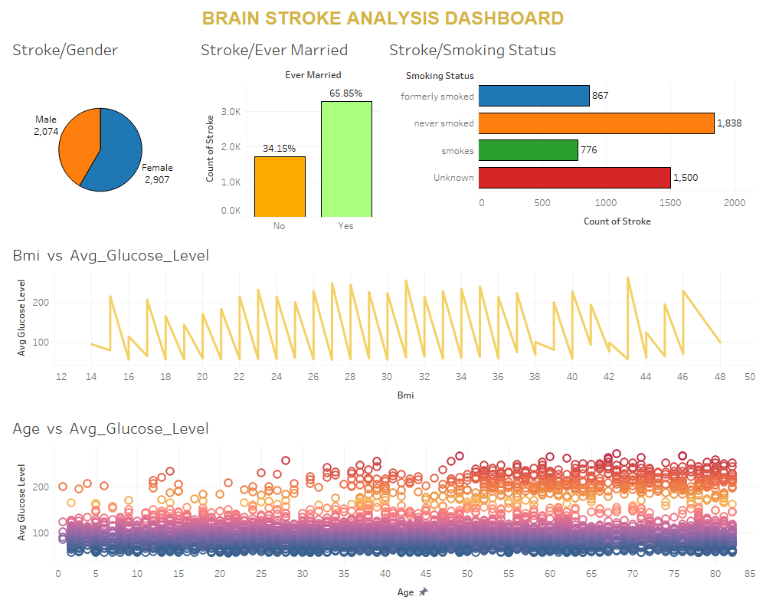

Slide 18
Why Machine Learning.?
We used various Machine Learning concepts in our project to do Exploratory Data Analysis.
We used different Models of Machine Learning to make predictions about the brain-stroke analysis.
Metrics of Machine Learning helped us to determine which Model of Machine Learning was best amongst all of them.

Slide 19
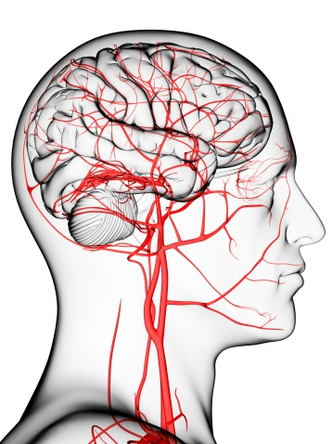
Model Evaluation
Models used for predictions of brain-stroke analysis.
Decision Tree
KNN
Random Forest
NaiveBayes
LDA Model
QDA Model

Slide 20






Model Evaluation
Accuracy, Precision Score, Recall Score and F1 Score for all the features of Models

Slide 21
Challenges:
The main challenges we faced during our project was to learn and study about the different machine learning concepts.
Another, challenge was to clean the data properly to be useful in the dashboard.
It was challenge to determine which machine learning model was best in our project.

Slide 22
References
https://www.kaggle.com/datasets/jillanisofttech/brain-stroke-dataset
http://www.google.com
https://www.medicalnewstoday.com/articles/7624

